Slide 1
BIMDAS
Miss L
Year 11 Essentials

Slide 2

Learning Intentions
Students will be able to
Use BIMDAS to answer calculations

Slide 3
While Miss L does the role…..
While you are waiting,
Use maths to estimate the number of light globes in W.A. homes given the population of W.A. is about 2.5 million.

Slide 4
Miss L’s logic
WA has about 2.5 million people in it.
There are about 4 people per family so 2.5 million ÷ 4 = 625,000
Miss L’s home has about 50 lights (including fridge, oven and outside)
625,000 x 50 = 31,250,000
What do you think – which assumptions could Miss L have wrong?

Slide 5
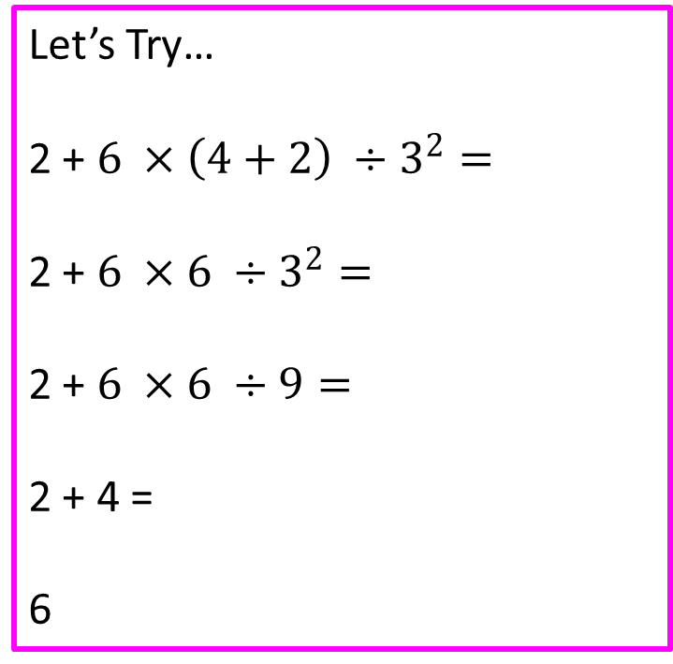
24
7
30
BIMDAS
Date
EQ – How do we use BIMDAS?
Order of Operations / BIMDAS
1. Brackets First
2. Indices
3. Multiply and/or Divide
(from left to right)
4. Add or Subtract
(from left to right)
Let’s Try…
2 + $6 ×\left(4+2\right) ÷3^{2}=$
2 + $6 ×6 ÷3^{2}=$
2 + $6 ×6 ÷9=$
2 + 4 =
6
What are the rules of BIMDAS?

Slide 6
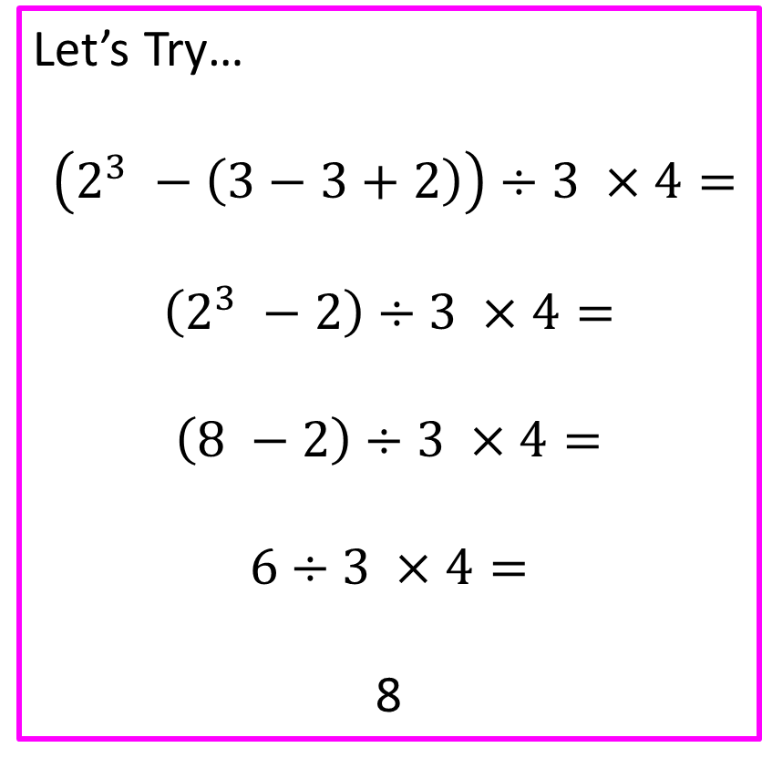
24
7
30
BIMDAS
Date
EQ – How do we use BIMDAS?
Order of Operations / BIMDAS
1. Brackets First
2. Indices
3. Multiply and/or Divide
(from left to right)
4. Add or Subtract
(from left to right)
Let’s Try…
$$\left(2^{3} −\left(3−3+2\right)\right)÷3 ×4=$$
$$\left(2^{3} −2\right)÷3 ×4=$$
$$\left(8 −2\right)÷3 ×4=$$
$$6÷3 ×4=$$
8
Inside brackets first
What are the rules of BIMDAS?

Slide 7


Slide 8
Task
DOMINOS GAME

Slide 9
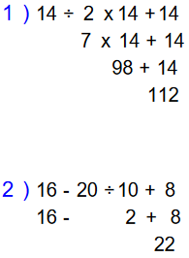
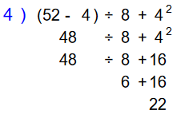
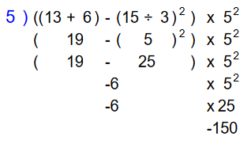
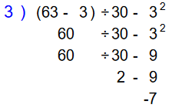
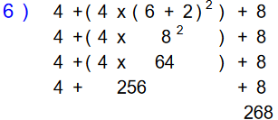
Task
Complete task
We will go over answers together
Complete Exit Pass and give to you teacher

